Slide 2
Computer system
Run program
Store data
Memory system

Slide 3
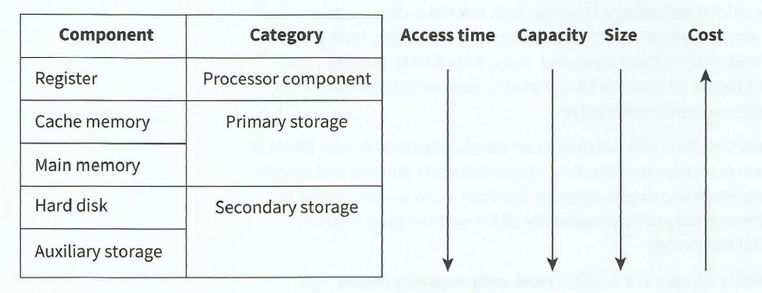
Memory system hierarchy
Show the trends in the important factors affecting this choice

Slide 4
Memory component
RAM
ROM
volatile memory that can be read from or written to any number of times
non-volatile memory that cannot be written to but can be read from any number of times

Slide 5
Dynamic RAM (DRAM) is constructed from capacitors which leak electricity and therefore need regularly recharging (every few milliseconds) to maintain the identity of the data stored .
Static RAM (SRAM) is constructed from flip –flops which continue to store data indefinitely while the computer system is switched on.
SRAM provides shorter access time
Otherwise, DRAM is better than SRAM

Slide 6
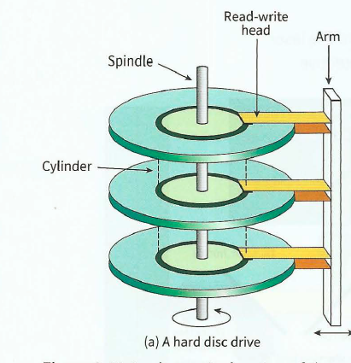
Secondary storage
Magnetic media: For either type of magnetic media the interaction with it is controlled by a read head and a write head. A read head uses the basic law of physics that a state of magnetisation will affect an electrical property; a write head uses the reverse law. Although they are
separate devices the two heads are
combined in a read-write head. The two
alternative states of magnetisation are
interpreted as a 1 or 0

Slide 7
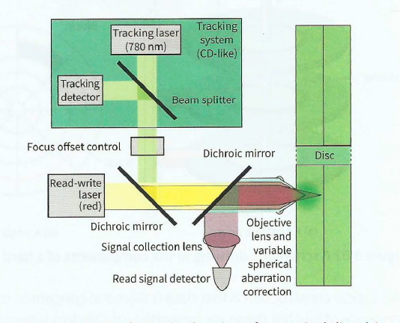
Secondary storage
Optical media : developed from existing technology not associated with computing systems. The compact disc (CD) evolved into CD digital audio (CD-DA) and this became the technology used in the
CD-ROM.
Notes:
For a CD-ROM, the reflective surface is manufactured with indentations, called 'pits', separated by what are referred to as 'lands'. When the disc is being read, the travel of the laser beam to a pit causes a difference in phase compared to reflection from a land. This phase
difference is recognized by the photodiode detector and attached circuitry and interpreted as a 1 or 0.

Slide 8
Secondary storage
Solid-state media : storage media that does not involve magnetic disks or any moving parts. For example, computer RAM (random access memory) uses solid-state media. RAM consists of microchips that store data on non-moving components, providing for fast retrieval of that data. Other good examples of solid-state devices are the flash drive and the solid-state drive or, SSD.

Slide 9
Hardware
Computer Mouse
Screen
Keyboard
Printers, scanners and plotters
Sound I/O

Slide 10
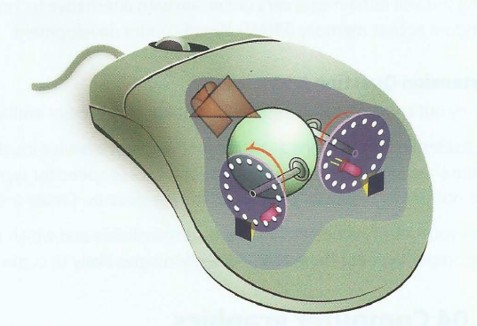
Computer mouse
tracker ball mouse :As the mouse moves the rubber ball rotates causing one or both rollers to rotate. Each roller is attached to a spindle on which there is a disc with holes arranged around the outer edge. A light beam and detector are arranged so that the intermitten transmission of the light through the holes in the disc is recorded as the disc rotates and the circuitry attached to
the pair of detectors then sends the appropriate data to the computer to activate movement of the screen cursor
Now mouse shine a light beam from a light emitting diode down onto the surface the mouse
is resting on to replace the ball

Slide 11
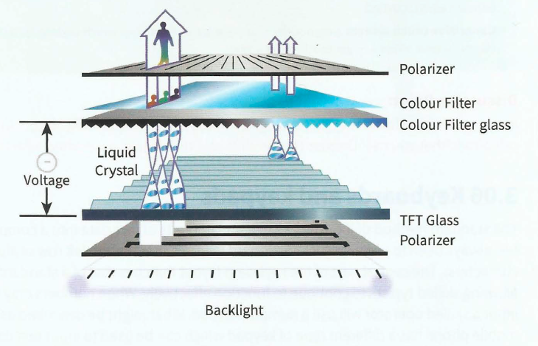
Screen display
a screen pixel consists of three sub-pixels typically one each for red, green and blue. Varying the level of light emitted from the individual sub-pixels allows a full range of colors to be displayed.
LCD screen has ind ividua l cells contain ing a liquid crystal to
create t he pixel matrix but these do not
emit light. The pixel matrix is illuminated
by back-lighting and each pixel can affect
the transm ission of this light to cause the
on-screen display.

Slide 12
Touch screens
resistive touch screen:
has two layers separated by a t hi n space beneath the screen surface .
capacitive touch screen:
finger touching a glass screen can cause a capacitance change in a circuit component immediately below the screen

Slide 13
Keyboards
When the keyboard is being used to input text it appears as though a key press immediately transfers the appropriate character to the computer screen but this is an illusion.
keyboard has electrical circuitry together with its own microprocessor and a ROM chip. The keys are positioned above a key matrix which consists of a set of rows of wires and another set of columns of wires. Pressing a key causes contact at a specific intersection.

Slide 14
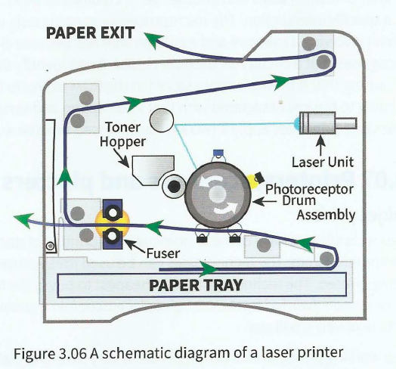
Printers, scanners and plotters
Inkjet printer
Laser printer
3D printer

Slide 15
I/O of sound
a microphone is needed. This is a device that has a diaphragm, a flexible material which is caused to vibrate by an incoming sound. If the diaphragm is connected to suitable circuitry the vibration can cause a change in an electrical signal.
a loudspeaker or speaker is needed. This is involved in what is effectively the reverse process to that for input. The computer sound card produces a digital signal which is converted to analogue by a digital-to-analogue converter. The analogue signal is fed to the speaker.
InpUT

